Slide 1


Similarity in Questions

Slide 2
Table of contents
01
04
02
05
03
06
Overview of datasets
ML Algorithms
Data Preprocessing & Cleaning
Hyperparameters tuning
Feature Engineering
Evaluation of results

Slide 3
Problem Statement:
Given 2 questions, do they have the same meaning?
Motivation:
Similarity Metric
Same word, different meaning (Semantics)
Synonyms
What model would bring about the greatest accuracy and why?
[Feature Engineering]
[ML Algorithms, Hyperparameter Tuning, Evaluation]

Slide 4
Overview of datasets
Kaggle
GLUE
(Data Science Competition Platform)
(General Language Understanding Evaluation)
train.csv
test.csv
train.tsv
test.tsv
dev.tsv

Slide 5
Overview of datasets
df_combined_train = [train.csv + train.tsv + dev.tsv]
808566 rows
id | qid1 | qid2 | question1 | question2 | is_duplicate
…

Slide 6
Overview of datasets
is_duplicate
“The ground truth is the set of labels that have been supplied by human experts. The ground truth labels are inherently subjective, as the true meaning of sentences can never be known with certainty”
…

Slide 7
Overview of datasets
df_combined_test = [test.csv + test.tsv]
2736761 rows
id | question1 | question2
…

Slide 8
Overview of datasets
df = df_combined_train

Slide 9


Data Preprocessing
Total number of rows = 808566
Total number of duplicated rows = 404276
Percentage of duplicated rows = 49.9991%

Slide 10
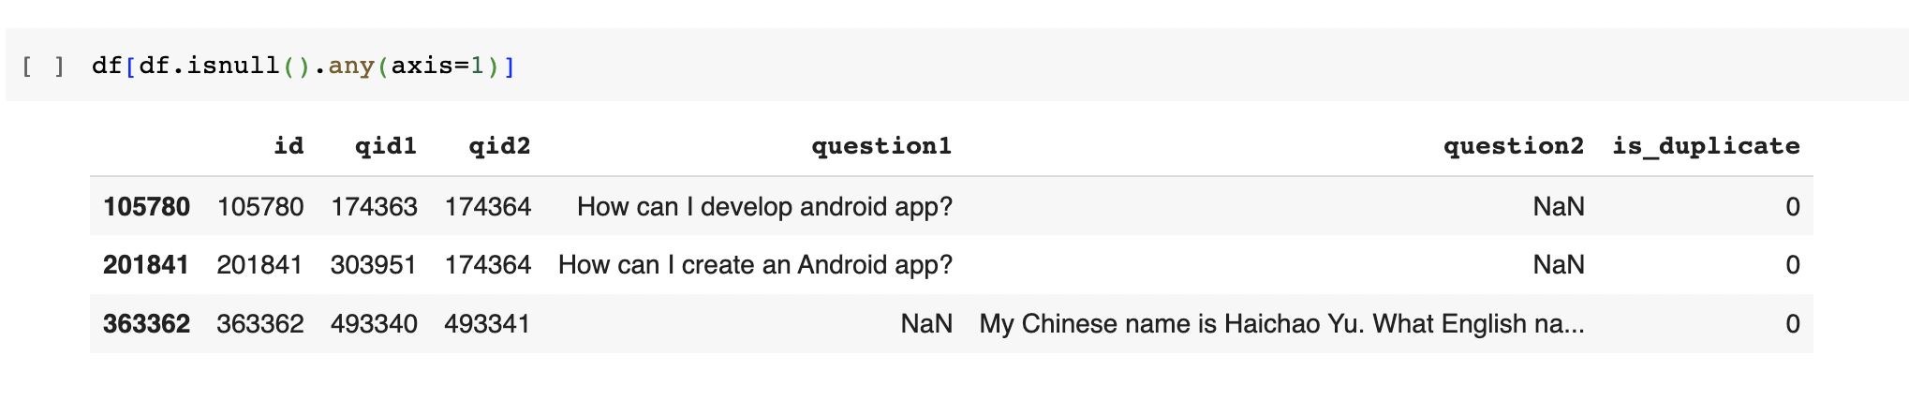
Data Preprocessing

Slide 11
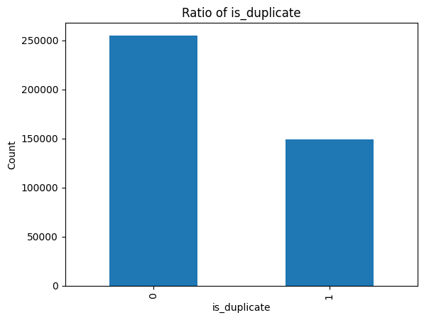
Data Preprocessing
255024 (is_duplicate=0) vs 149263 (is_duplicate=1)
(63.08%)
(36.92%)

Slide 12
Data Cleaning
Converting to lowercase
Expanding Contractions
Contractions are shortened versions of words or syllables.
E.g I’ll → I will, don’t → do not
Removing Hyperlinks
URLs contain a combination of letters, numbers, and special characters that may not contribute much to the semantic meaning of the text. Reduce the noise in the text data

Slide 13
Data Cleaning
Removing HTML Tags
HTML tags are noise and don’t add much value to understanding and analyzing text
E.g <head>, <title>, <br>...
Standardizing Accent Characters
Convert characters into standard ASCII characters (E.g è→ e, ã → a)
Remove Non English characters
Removing Mentions and Hashtags #,@
Don’t generalize across samples and are noise in most NLP tasks

Slide 14
Data Preparation
Feature Engineering

Slide 15
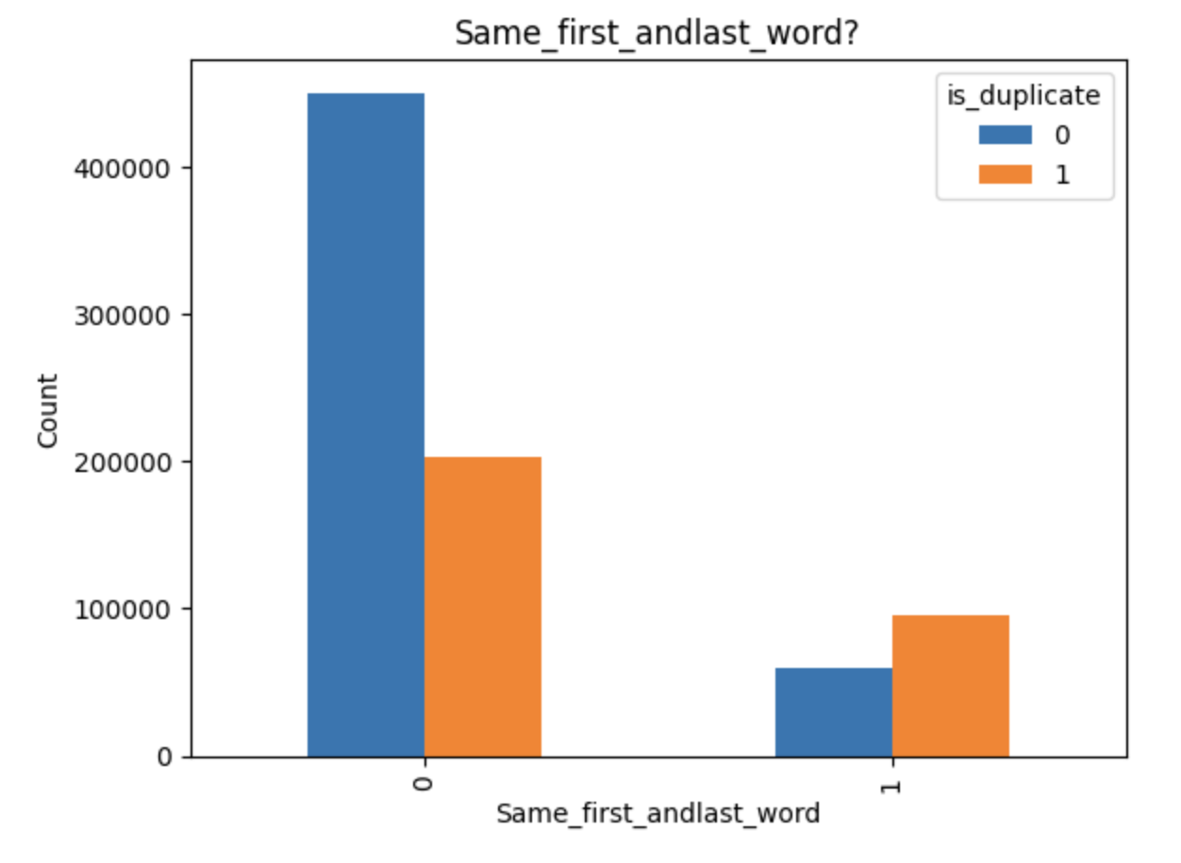
Feature Engineering
Question length ratio
The questions will be split by words when vectorised so it is beneficial in enhancing similarity comparisons in text analysis
Number of words ratio
Ratio of the number of words in the shorter question over the length of the longer question
Same First and Last words
Duplicate question pairs tend to have a larger proportion of pairs with same first and last words, vice versa.
Fig.1

Slide 16
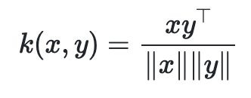
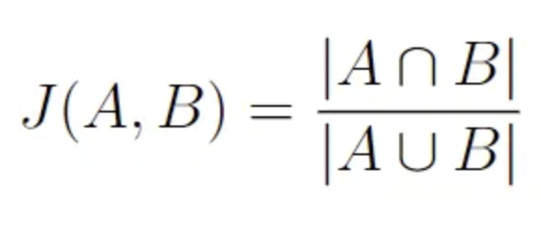
Feature Engineering
4. Cosine Similarity
Focuses on the direction of the vector
The cosine similarity ranges from -1 to 1.
1 implies the documents are identical.
0 implies the documents are orthogonal (no similarity).
−1 implies the documents are diametrically opposed.
Done by converting questions into bag of words representation and transforming into vector representation.
5. Jaccard Similarity
Quantifies how similar the sets are by comparing their shared elements with their total combined elements.
Done by tokenizing and lemmatizing the questions and filtering the stop words
Notes:
It provides a measure of similarity that is independent of the magnitude of the vectors, focusing only on the direction.
The resulting measure of similarity spans from -1, signifying complete opposition, to 1, indicating absolute identity. A value of 0 signifies orthogonality or decorrelation, while values in between denote varying degrees of similarity or dissimilarity.
Quantifies how similar the sets are by comparing their shared elements with their total combined elements.
Does not take into account the order of elements, and the focus is on the presence or absence of specific elements.

Slide 17
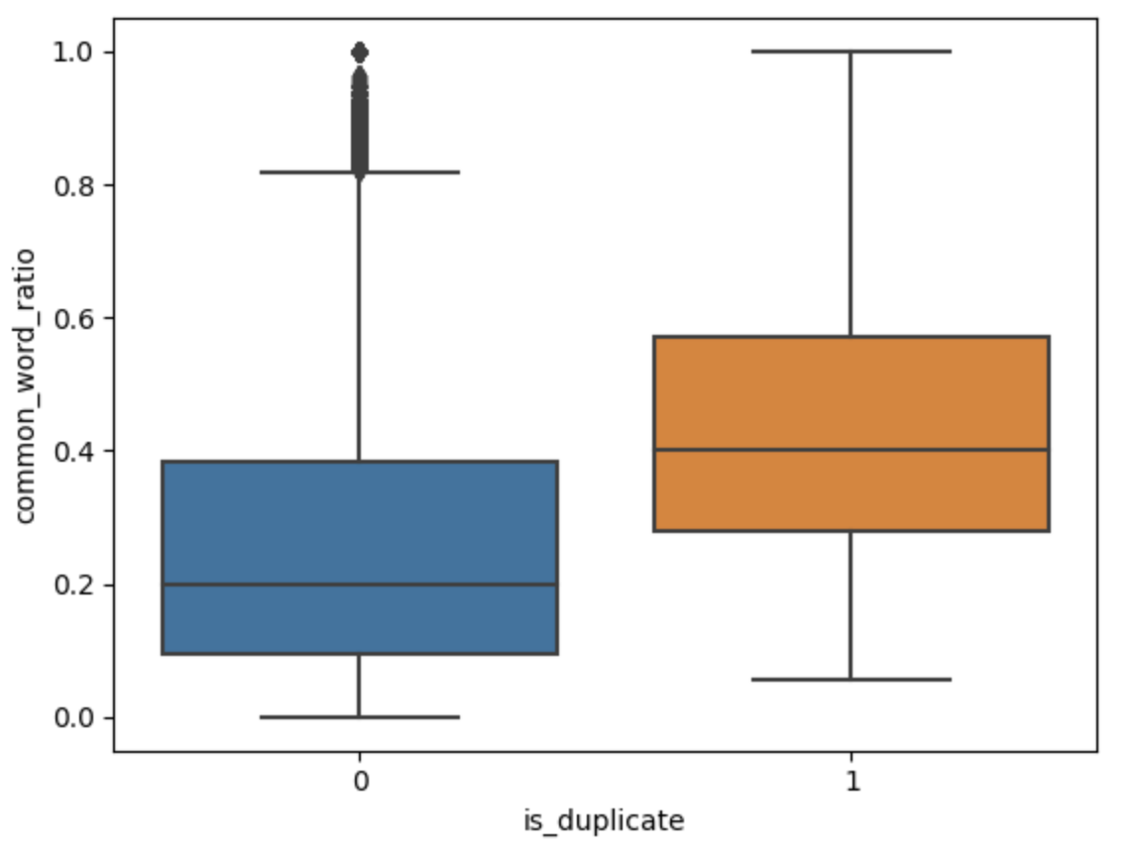
Feature Engineering
6. Common words to unique words ratio
Duplicate question pairs tend to have more common words between both the question
7. Common stop words to unique words ratio (csc_ratio)
To see the influence of stop words on similarity of questions

Slide 18
Feature Engineering
Purpose: It enhances the accuracy of the data insights by overcoming complexities in data such as spelling variations, spelling mistakes, duplicate entries, abbreviations
8. Fuzzy Simple Ratio
Measures the similarity between two strings by calculating the minimum number of single-character edits needed to transform one string into the other.
9. Fuzzy Partial Ratio
It is effective to identify matches when one string is a subset or prefix of the other.
10. Fuzzy Token Sort Ratio
It captures the essence of the strings' content rather than their specific order

Slide 19
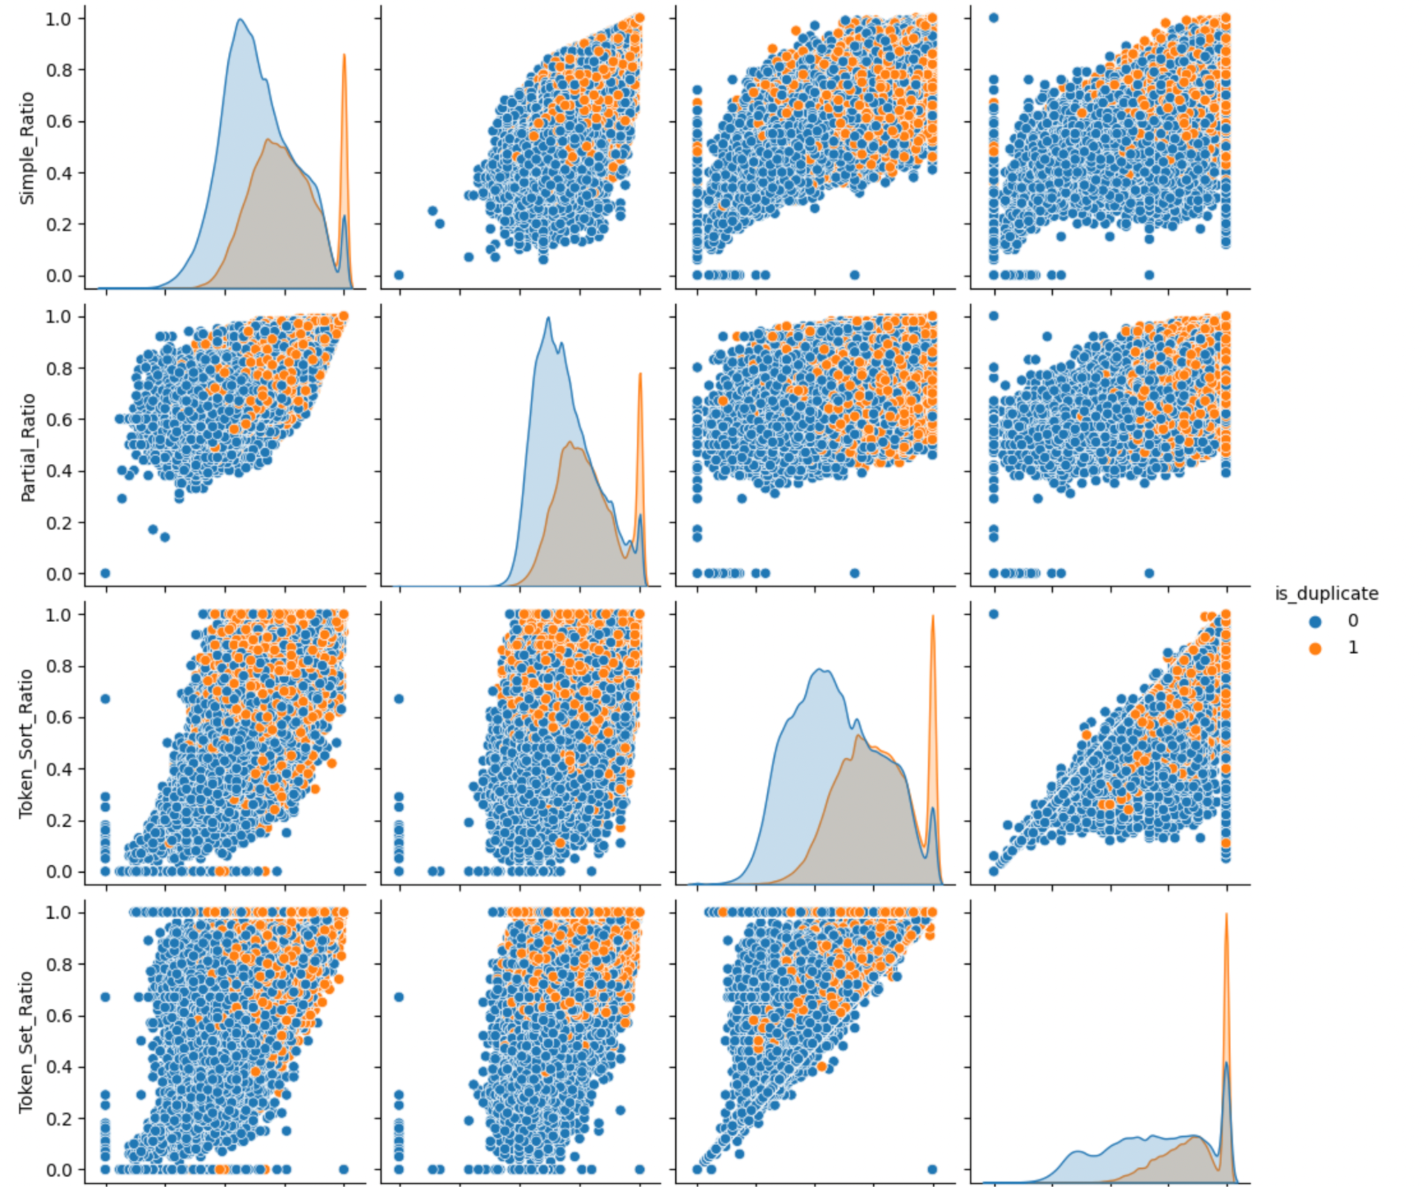
Feature Engineering
11. Fuzzy Token Set Ratio
handles cases where word order differs but the same set of words exists in both strings
From the pair plot, we are able to differentiate between duplicate and non-duplicate where the blue coordinates are distinctly separated from the orange coordinates in the scatterplots. This implies that the plotted features are good discriminators for the categories.

Slide 20
Feature Engineering
TF-IDF Weighted Word-Vectors
There is value in words present in the questions, so we use TF-IDF as a numerical way to vectorize text data
Reflects how important a word is to a document in a collection or corpus of documents
Spacy GLOVE Model
After finding the TF-IDF scores, we convert each question to a weighted average of word2vec vectors by these scores.
This created 300 features respectively for question 1 and question 2.
Notes:
As GLOVE is a pre-trained model trained on wikipedia, it possesses greater semantic strength in terms of individual words.

Slide 21
Feature Engineering
12. Semantic Cosine Similarity
13. Semantic Euclidean Distance
Created to relate the words vectors generated for question 1 and question 2 respectively together
14. Semantic Correlations
To see the correlation between the word vectors generated for question 1 and question 2 respectively

Slide 22
Feature Engineering Conclusion
Statistical & NLP Features
Dimension: 11
Vector Features
Dimension: 600
Semantic Relation Features
Dimension: 3
Total features = Statistical & NLP Features + Semantic Relation Features
Dimension: 14

Slide 23
Evaluation
How we evaluate models used

Slide 24
Real world distribution of data
Non-duplicate pair of questions
Duplicate pair of questions

Slide 25
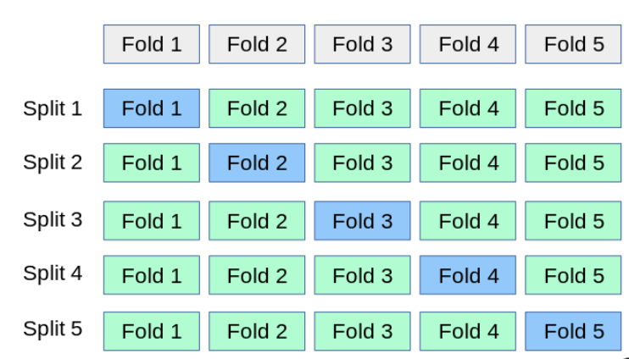
How to evaluate the performance of our model?
Use K-fold cross validation to get evaluation scores of different metrics

Slide 26
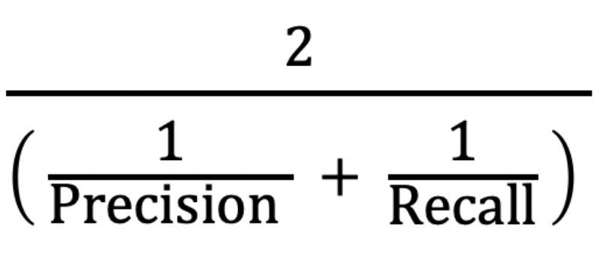
Evaluation Metric - F1 Score
Accounts for imbalanced dataset
Balances between precision and recall
Precision ensures that the model do not excessively mark pairs of question as similar so as to prevent user from getting a notified of two unrelated questions being similar.
Recall ensures that the model does not miss out on potential similar questions that Quora can mark as being similar.

Slide 27
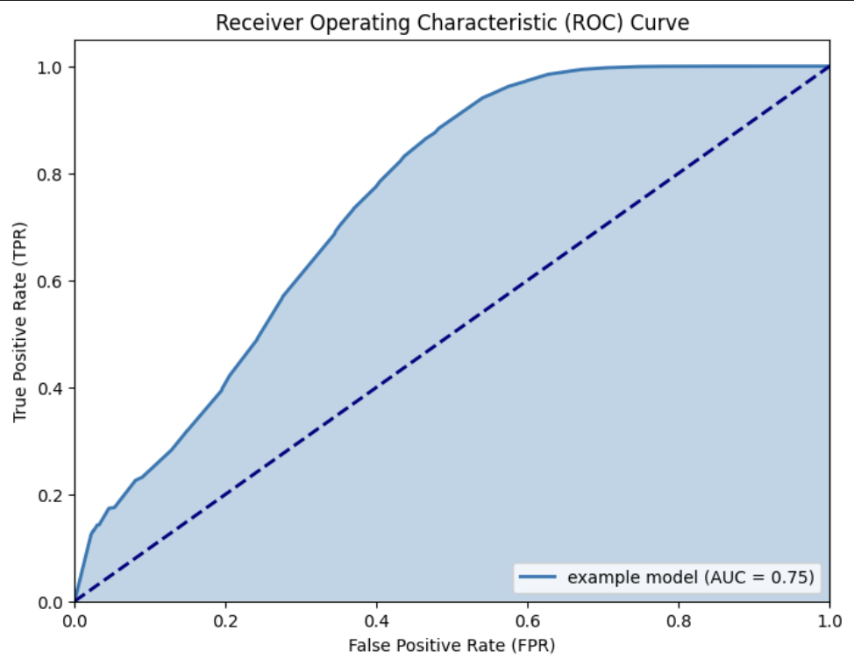
Evaluation Metric - ROC AUC
Area under curve of the Receiver Operating Characteristic
Accounts for imbalanced dataset
Provides a comprehensive view of the different model’s ability to differentiate between similar and non-similar pairs of questions for multiple thresholds

Slide 28
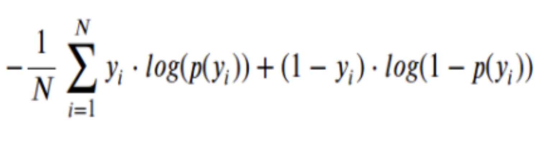
Evaluation Metric - Log Loss
Logarithmic Loss
Quantifies the difference between predicted probabilities and actual outcome
Penalizes confident misclassification
Can prevent over reliance on certain features leading to suboptimal generalization

Slide 29
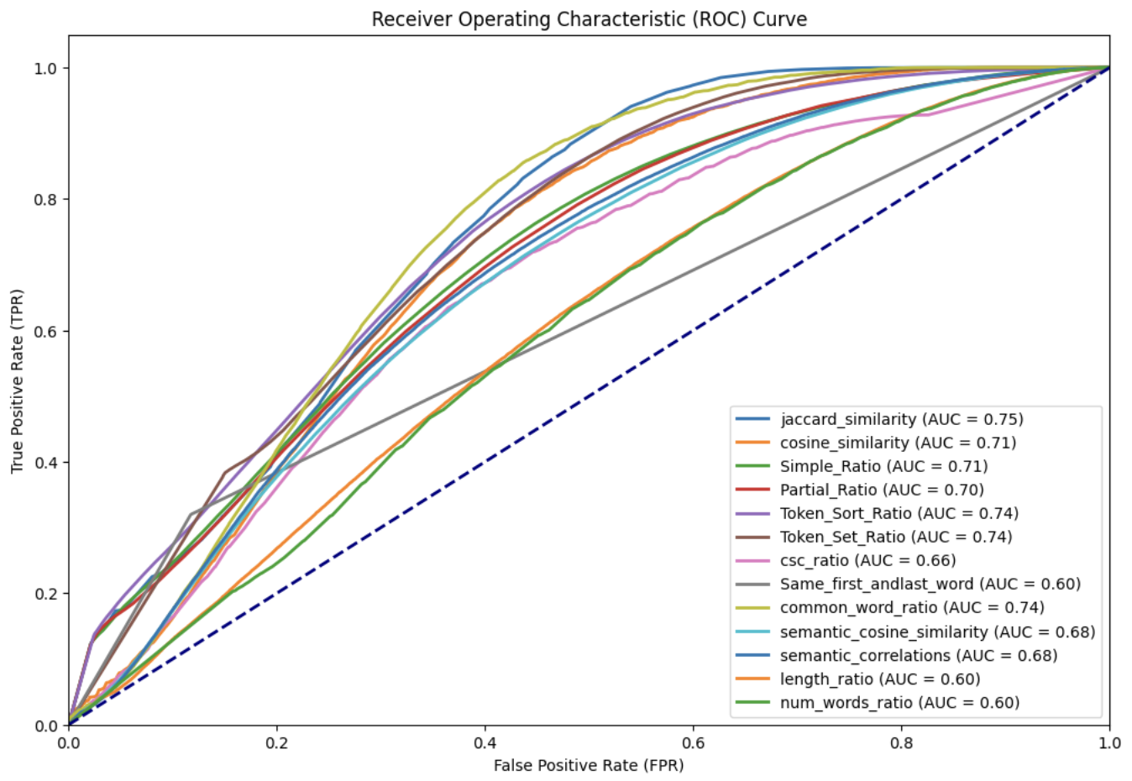
Feature evaluation
ROC_AUC of some similarity features if we use the individual feature for classification

Slide 30
ML Algorithms
Baselines and Tuning

Slide 31
Our Approach to ML
Preliminary models
Random model
5 ML classification models:
Logistic Regression
SVM
Decision Tree
Random Forest
XGBoost
Tuning for best models
Hyperparameter tuning
Feature selection (RFE)

Slide 32
ML Models
1. Baseline: Random model
Model
Serves as a baseline to compare evaluation metrics of of ML algorithms
Used sklearn’s Dummy Classifier with the ‘stratified strategy’
Evaluation
F1 score: 0.37 | ROC AUC: 0.50 | Log-Loss: 16.75
Poor performance expected as it is random
Log-loss value serves as a benchmark
2. Logistic regression
Model
Regularized logistic regression model with stochastic gradient descent (SGD) learning
Evaluation
F1 score: 0.54 | ROC AUC: 0.65 | Log Loss: 0.54
Improved log-loss, but F1 score remains low
Reasons for poor performance:
correlated features
lack of expressivity

Slide 33
ML Models
3. SVM
Model
Radial kernel approximation
Linear Support Vector Classification
Evaluation
F1 score: 0.64 | ROC AUC: 0.71 | Log Loss: 0.48
Improvement over logistic regression
Data not linearly separable, so SVM is less preferred compared to tree methods
4. Decision Tree
Model
A tree-like classification models by making decisions based on features' values to classify instances.
Evaluation
F1 score: 0.65 | ROC AUC: 0.72 | Log Loss: 0.47
Improvement from logistic regression and SVM

Slide 34
ML Models
5. Random Forest
Model
Trains multiple decision trees in parallel and decides final class by majority vote
A bagging technique to decrease variance and control over-fitting
Evaluation
F1 score: 0.70 | ROC AUC: 0.76 | Log Loss: 0.43
Improvement over a single decision tree as it uses bagging
6. XGBoost
Model
Sequentially creates decision trees and improves on mistakes of previous trees
A boosting technique to reduce bias and improve performance
Evaluation
F1 score: 0.71 | ROC AUC: 0.77 | Log Loss: 0.43
Similar performance to random forest

Slide 35
Hyperparameter Tuning
Rationale
Tree-based methods worked better than linear models and margin-based classifiers
Concluded that the 2 best models were XGBoost (F1 score: 0.71, AUC_ROC: 0.77), RandomForest (F1 score: 0.70, AUC_ROC: 0.76)
Improvement in the performance of the model using hyperparameter tuning, searching for the parameters using Halving GridSearch
First set the gridsearch to a large range and then narrowed the range down via trial and error

Slide 36
Hyperparameter Tuning
Outcome
Random Forest
Evaluation
F1 score: 0.71 | ROC AUC: 0.77 | Log Loss:
0.43
Slight Improvement in F1 score and ROC-AUC, but log loss remains the same
XGBoost
Evaluation
F1 score: 0.71 | ROC AUC: 0.77 | Log Loss: 0.43
Slight improvement in ROC-AUC, but F1 score and Log loss remains the same
Limitations for Hyperparameter Tuning:
Param grid used may not be large enough during GridSearch

Slide 37
Recursive Feature Selection
Rationale
To find out if we can improve model performance through the dropping of less important features for each individual model
Plotting of graph with the Number of Features Selected against Score for the model
Function to also output a table which tells us which features are selected based on the importance value they are assigned
Outputs a model with selected features that are deemed important for that particular model

Slide 38
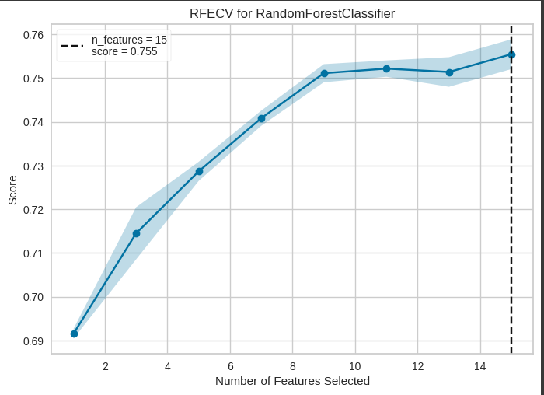
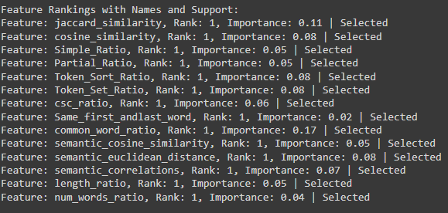
Recursive Feature Selection
Outcome for RandomForest
Score: 0.755
All the features were selected for Random Forest

Slide 39
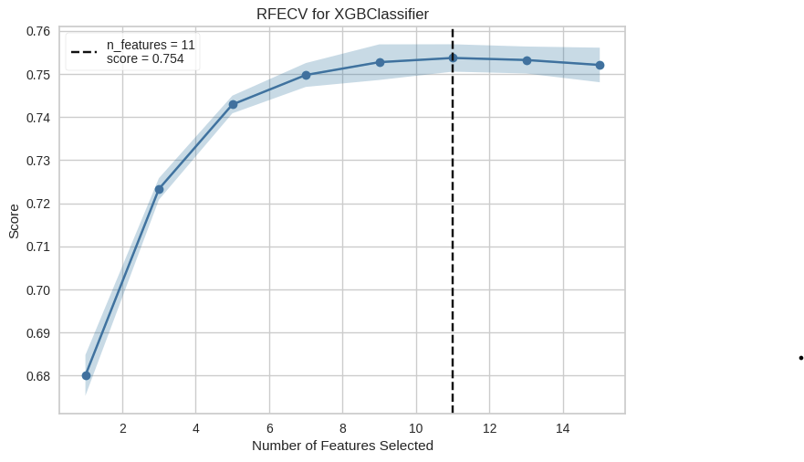
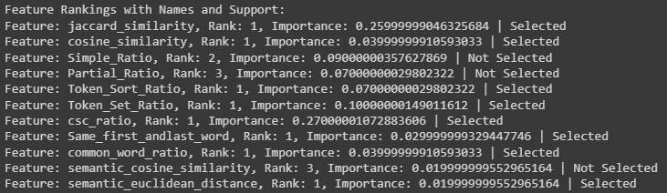
Recursive Feature Selection
Outcome for XGBoost
Score: 0.754
3 of the features were not selected for XGBoost after the function detected a drop or no change in the model performance
Could be due to the fact that the 3 excluded features did not provide any additional information gain and considered as noise in the data

Slide 40
Conclusion
Random Forest
F1 score: 0.71
ROC AUC: 0.77
Log Loss: 0.43
XGBoost
F1 score: 0.70
ROC AUC: 0.76
Log Loss: 0.44

Slide 41
Thank you!

